Slide 1

Endocrine system
Dr/Ebtihal Kamal

Slide 2
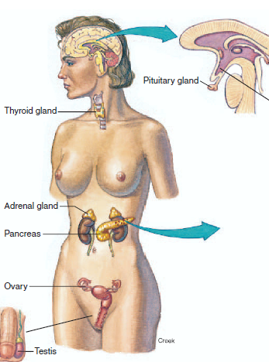

Slide 3
Endocrine glands lack the ducts that are present in exocrine glands
The endocrine glands secrete their products, which are biologically active molecules called hormones into the blood.
Hormones are regulatory molecules secreted into the blood by endocrine glands.

Slide 4
Chemical Classification of Hormones
Hormones secreted by different endocrine glands vary widely in chemical structure.

Slide 5
Amines. These are hormones derived from the amino acids tyrosine and tryptophan. They include the hormones secreted by the adrenal medulla, thyroid glands.

Slide 6
Polypeptides and proteins. Polypeptide hormones
generally contain less than 100 amino acids; an example is anti diuretic hormone
Protein hormones are polypeptides with more than 100 amino acids; growth hormone is an example

Slide 7
Glycoproteins.
These molecules consist of a long polypeptide (containing more than 100 amino acids) bound to one or more carbohydrate groups. Examples are follicle-stimulating hormone (FSH) and luteinizing hormone (LH).

Slide 8
Steroids. These are lipids derived from cholesterol. They include the hormones testosterone, estradiol, progesterone, and cortisol

Slide 9
Transport of hormones
steroid and thyroid hormones are transported in the blood bound to plasma proteins. The serum concentrations of free hormone , plasma protein and bound hormone are in equilibrium

Slide 10
When the concentration of the free form of a hormone decreases, then more of this hormone will be released from the binding proteins.
The free hormone is the biologically active form. It binds to the target tissue to cause its actions and is involved with the negative feedback control of its secretion

Slide 11
The binding of hormones to plasma proteins has several beneficial effects, including:
• Facilitation of transport
• Prolonged half-life
• Hormone reservoir

Slide 12
Functional classification of hormones
• Trophic hormones
• Nontrophic hormones
A trophic hormone acts on another endocrine gland to stimulate secretion of its hormone. For example, thyrotropin, or thyroid-stimulating hormone (TSH), stimulates the secretion of thyroid hormones. Adrenocorticotropin, or adrenocorticotropic hormone (ACTH), stimulates the adrenal cortex to secrete the hormone cortisol

Slide 13
A nontrophic hormone
acts on nonendocrine target tissues. For example, parathormone released from the parathyroid glands acts on bone tissue to stimulate the release of calcium into the blood. Aldosterone released from the cortical region of the adrenal glands acts on the kidney to stimulate the reabsorption of sodium into the blood.

Slide 14
Hormone interactions
The three types of hormone interactions include:
• Synergism
• Permissiveness
• Antagonism

Slide 15
Synergism : When two hormones interact at the target tissue such that the combination of their effects is more than additive, synergism occurs. In other words, their combined effect is greater than the sum of their separate effects. For example, epinephrine, cortisol, and glucagon are three hormones that each increase the level of blood glucose.

Slide 16
Permissiveness: one hormone enhances the responsiveness of the target tissue to a second hormone; in other words, the first hormone increases the activity of the second. For example, the normal maturation of the reproductive system requires reproductive hormones from the hypothalamus, pituitary, and gonads as well as the presence of thyroid hormone.

Slide 17
Although thyroid hormone by itself has no effect on the reproductive system, if it is absent the development of this system is delayed. Therefore, thyroid hormone is considered to have a permissive effect on the reproductive hormones, facilitating their actions causing sexual maturation

Slide 18
Antagonism: When the actions of one hormone oppose the effects of another, the result is antagonism For example, insulin decreases blood glucose and promotes the formation of fat. Glucagon, on the other hand, increases blood glucose and promotes the degradation of fat. Therefore, the effects of insulin and glucagon are antagonistic.

Slide 19
Mechanisms of hormone action
The binding of a hormone to its receptor initiates intracellular events that direct the hormone’s action
the mechanism by which this occurs depends on the location of the hormone receptor. Receptors are typically located on the cell surface or in the cell nucleus

Slide 20
two general mechanisms:
• Signal transduction and second messenger systems
• Gene activation

Slide 21
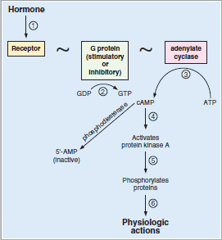

Slide 22
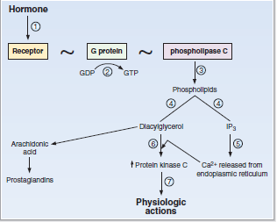

Slide 23
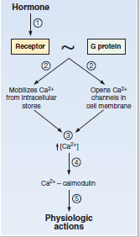

Slide 24
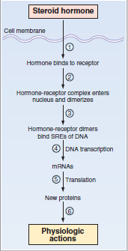

Slide 25
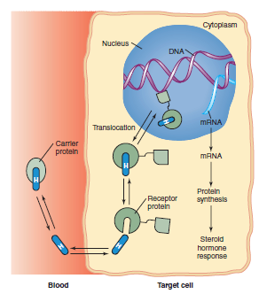

Slide 26
Protein/peptide hormones and the catecholamines are water-soluble substances and, accordingly, are unable to cross the plasma membrane to enter the cell. Therefore, these hormones must bind to their specific receptors on the cell surface. This receptor binding causes a response within the cell by way of signal transduction or by the production of intracellular second messenger molecules
.

Slide 27
The steroid hormones bind to intracellular receptor because they are lipid soluable and able to cross the cell membrane

Slide 28
The most common second messenger activated by protein/peptide hormones and catecholamines is cyclic adenosine monophosphate(cAMP)

Slide 29
The process begins when the hormone binds to its receptor.On the cytoplasmic surface of the membrane, the receptor is associated with a G
Protein that serves as the transducer molecule. In other words, the G protein acts as an intermediary between the receptor and the second messengers that will alter cellular activity

Slide 30
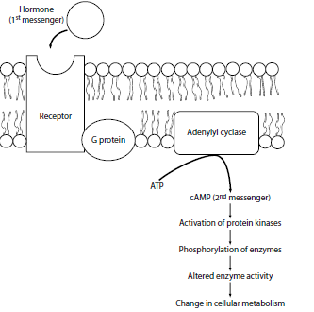

Slide 31
The cAMP molecule serves as the second messenger, which carries out the effects of the hormone inside the cell. The primary function of cAMP is to activate protein kinase A .This kinase then attaches phosphate groups to specific enzymatic proteins in the cytoplasm. The phosphorylation of these enzymes enhances or inhibits their activity, resulting in the enhancement or inhibition of specific cellular reactions and processes

