Slide 1
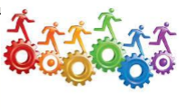
Assessment of Learning Outcomes
Dr.Yasir Elhassan
Associate professor Clinical Anatomist
Member Of Program Administrative Board
Head of the Program Assessment Committee (PAC)
Phase 1 Director 17/11/2018

Slide 2
Expected Learning Outcomes for this Workshop
By the completion of the workshop, participants will be able to:
➢Integrate the four phases of assessment (planning, implementing, reviewing, and improving) into the program assessment plan;
➢Define program mission, learning goals, and learning objectives;
➢Develop and/or revise the student learning outcomes for a degree program;
➢Select appropriate assessment measures for each student learning outcome;

Slide 3
Expected Learning Outcomes for this Workshop…
➢Establish criteria for success for student performance in relation to those student learning outcomes;
➢Create and/or update an assessment plan that outlines the specific methods that will be used to assess the student learning outcomes;
➢Identify ways that degree programs will use assessment data to make improvements to student learning; and
➢Write an effective assessment report.

Slide 4
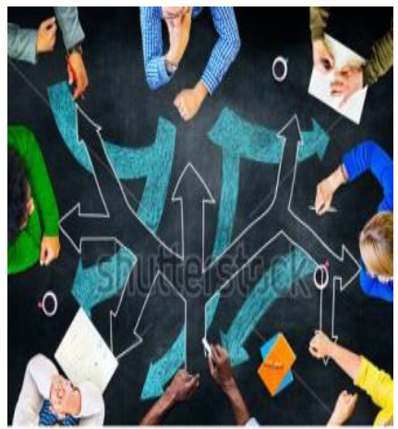

Approach
➢Please respond during the presentations and work hard during the activities!
➢We hope you will find the workshop enjoyable now and useful later

Slide 5
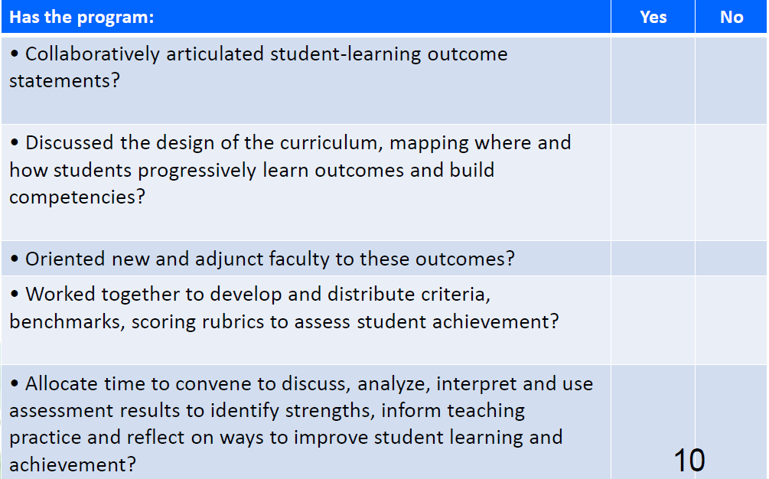

Review your Program’s Assessment Planning Process

Slide 6
Learning and Teaching
“Student learning outcomes must be clearly specified, consistent with the requirements for employment or professional practice.
Standards of learning must be assessed and verified through appropriate processes and benchmarked against demanding and relevant external reference points.”
“Teaching quality and the effectiveness of programs must be evaluated through student assessments and graduate and employer surveys with evidence from these sources used as a basis for plans for improvement”.

Slide 7
Assessment and Accreditation…
“Student Evaluation processes must be appropriate for
the intended learning outcomes and effectively and fairly
administered with independent verification of standards
achieved.”
“A learning outcome describes what a student knows and can
do in measurable terms that are demonstrated and assessed
by direct and indirect assessments”.
To satisfy these requirement:
➢Student evaluation measures should be appropriate for the different forms
of learning sought.
➢Evaluation practices should be clearly communicated to students at the
beginning of courses.
➢Appropriate, valid and reliable methods should be used for verifying
standards of student achievement in relation to relevant
internal and external benchmarks.
12

Slide 8
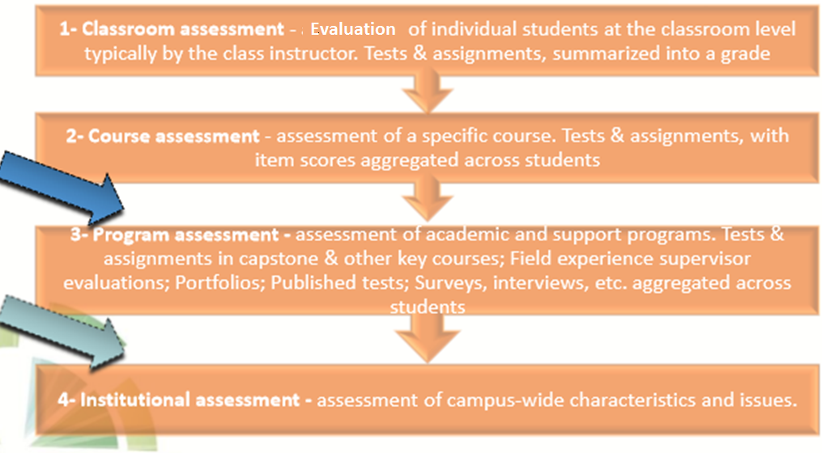
Levels of Assessment

Slide 9
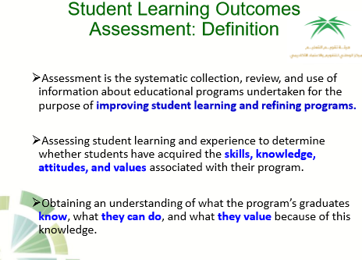

Slide 10
Purposes of Assessment
➢To determine how well students are learning.
➢To provide feedback on how the program can be improved.
➢To inform students, faculty members, parents, policy makers, and
the public about the effectiveness of educational services.
➢To demonstrate to students, faculty, staff and other stakeholders
what the program is accomplishing.
➢To provide support for campus decision-making activities such as
program review and strategic planning, as well as external
accountability activities such as accreditation.

Slide 11
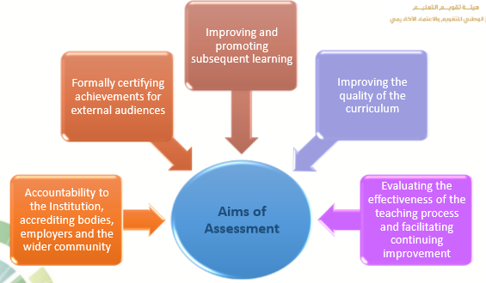
Aims of Assessment

Slide 12
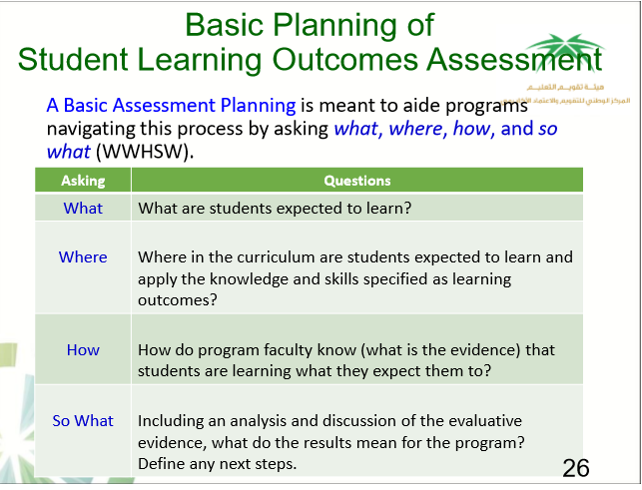

Slide 13
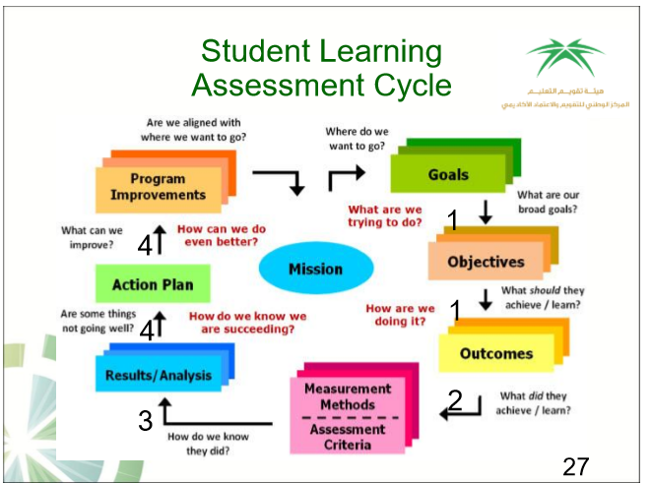

Slide 14
Preliminary Step: Organize for Assessment
➢Form a Program Assessment Committee (PAC) from the faculty body
responsible for collecting, reviewing, interpreting, and disseminating
program assessment data.
➢Design of common formats and assessment templates should flow from PAC
➢All faculty members should participate in the assessment process and should
assist PAC in collecting, compiling, and organizing information and data for
each mandated assessment tool.
➢An institutionally based faculty assessment committee should have an
oversight role on all assessment activities that take place at the program level.

Slide 15
Dean
Administrative flow- chart of the College of medicine program
Program Administrative Board
Medical Education Department
Professional Development
Unit
Quality Deanship
Vice Dean for Academic Affairs
Program Assessment Committee
Examination Office
Program Coordinator
Professional Development Unit
Program executive Committee
Year 2 Lead
Year 3 Lead
Year 4 Lead
Year 5 Lead
Year 6 Lead
PEP Lead
PPD Lead
Phase 1 Committee
Phase 2 Committee
Phase 3 Committee
PEP executive Committee
PPD executive Committee

Slide 16
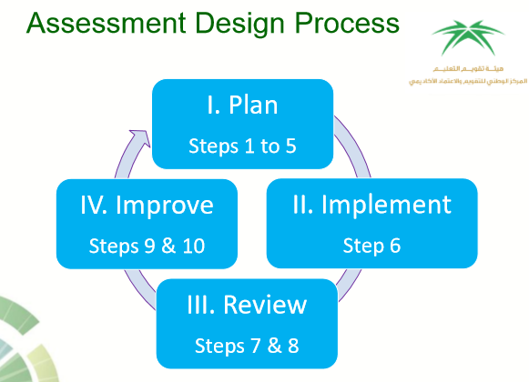

Slide 17
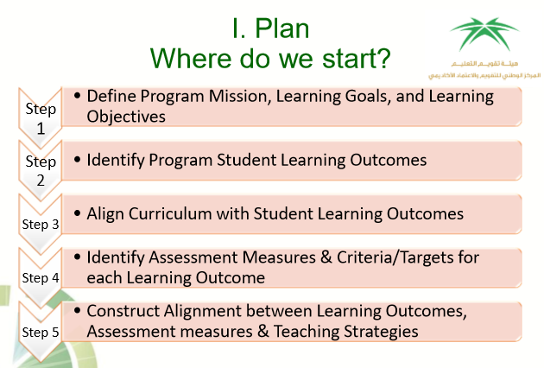

Slide 18
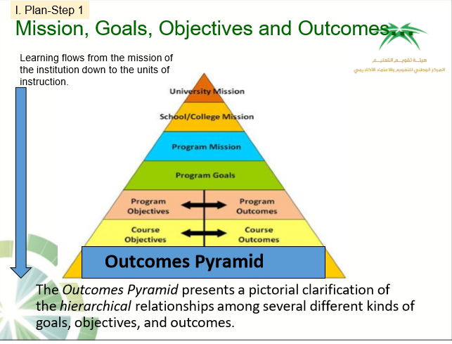

Slide 19
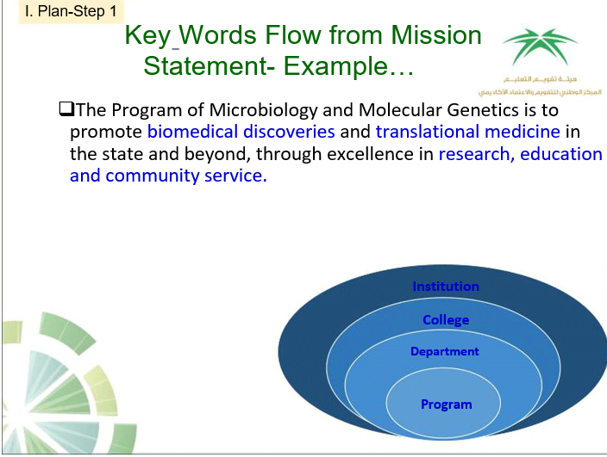

Slide 20


Slide 21
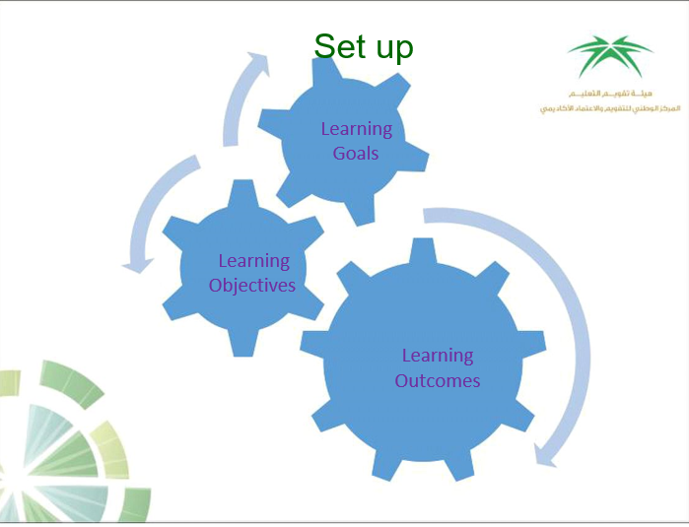

Slide 22
I. Plan-Step 1
Learning Goals of the Program
➢Learning Goals are the general aims or purposes of the program and its curriculum.
➢Learning Goals are broad, focused to the discipline and key concepts and competencies, and
general statements of what the program intends to accomplish
➢Learning Goals should be consistent with the mission of the program and the
goals of the institution.
➢A single learning Goal may have many specific subordinate learning objectives.
➢In current practice, many programs move directly from the Mission to the
Program Learning Objectives without explicitly defining the goals as a separate
category, while others move from Program Learning Goals directly to
Student Learning Outcomes.
.

Slide 23
I. Plan-Step 1
Examples of Learning Goals
➢Students will understand and grasp the fundamental
concepts of the discipline.
➢Students will address issues critically and reflectively.
➢Students will work well with others.
➢Students will have commitment to open-minded inquiry and
lifelong learning.
➢Graduates of will be knowledgeable of the principles of
modern patient care science.
➢Graduates will master the art of critical thinking in the
decision-making process as competent professionals.
➢Students will be competent in critical questioning and
analysis.
50

Slide 24
I. Plan-Step 1
Learning Objectives
➢ Learning Objectives describe the intended purposes and expected results of teaching
activities and establish the foundation for assessment.
➢Learning Objectives describe what faculty will cover in a program/course.
➢They are generally less broad than goals and more broad than student learning outcomes
.

Slide 25
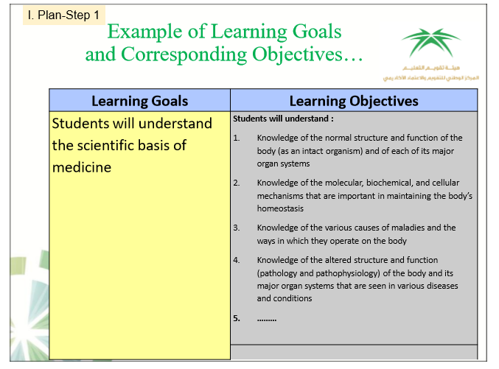

Slide 26
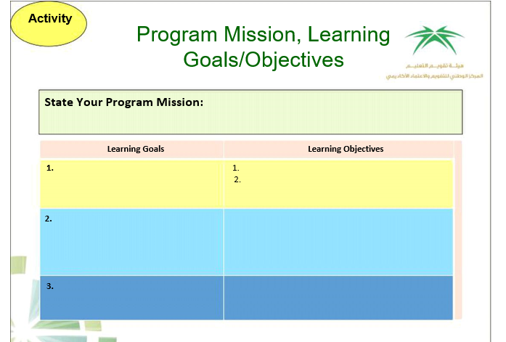

Slide 27
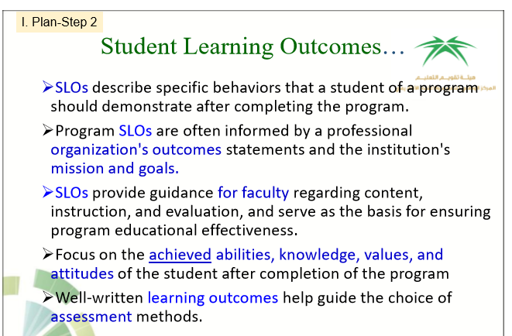

Slide 28
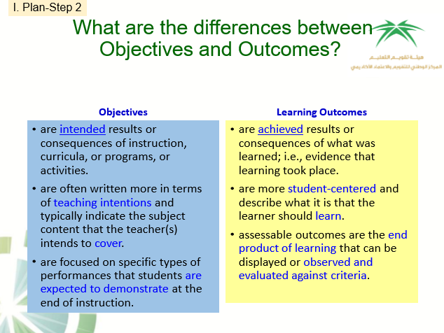

Slide 29
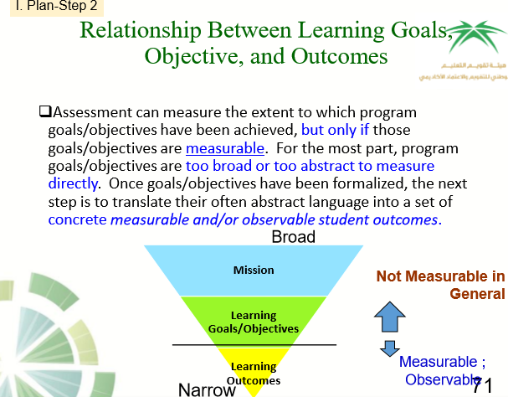
Measurable Observable

Slide 30
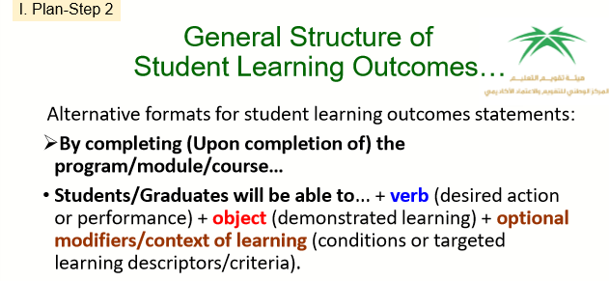

Slide 31
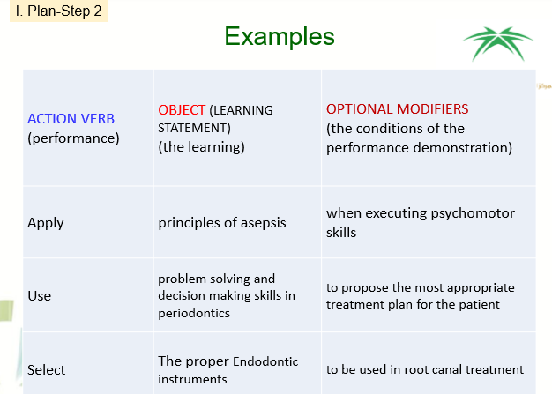

Slide 32
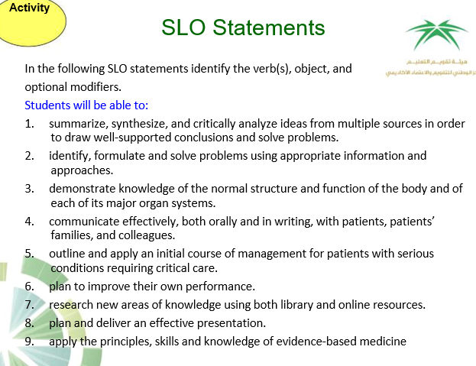

Slide 33
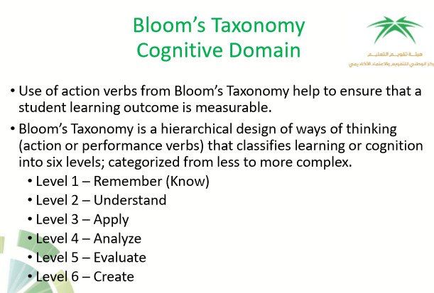

Slide 34
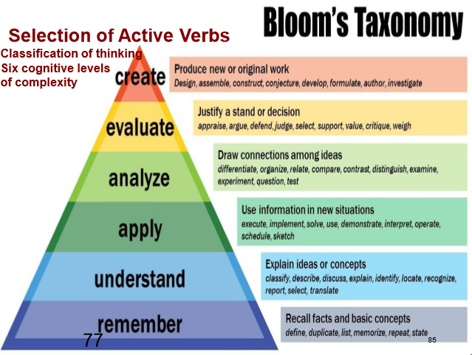

Slide 35
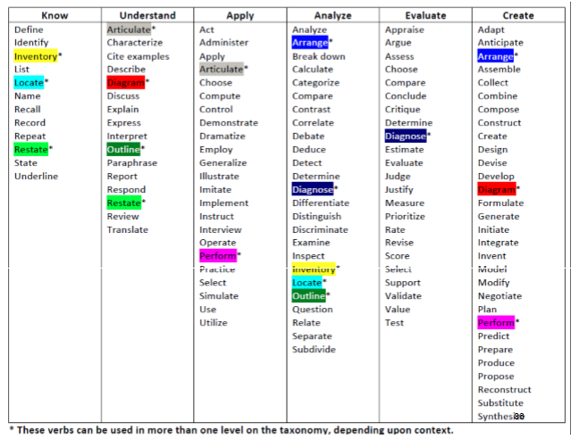

Slide 36
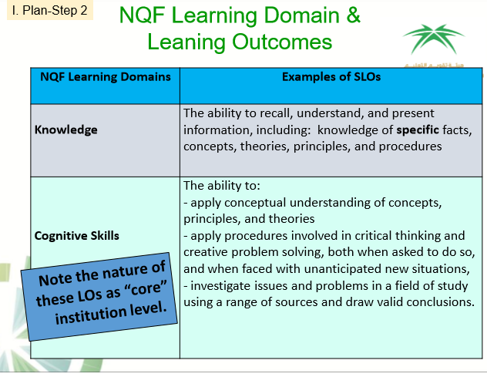

Slide 37
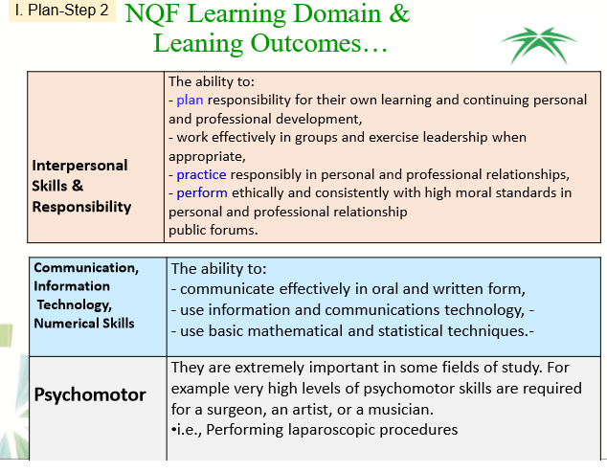

Slide 38
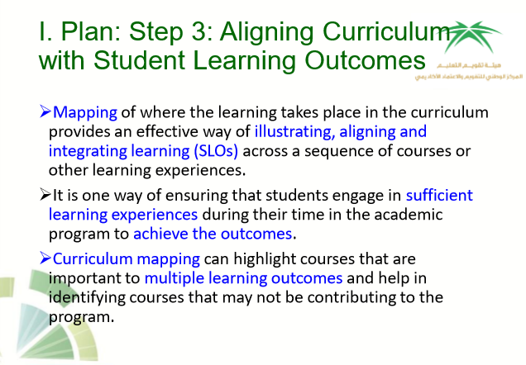

Slide 39
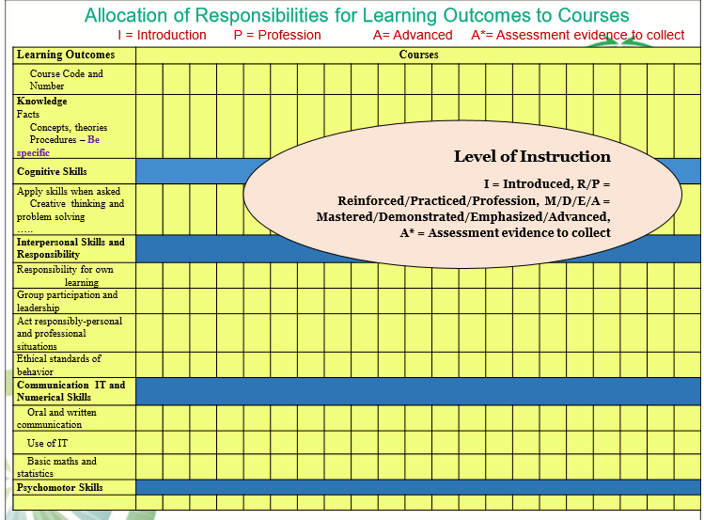

Slide 40
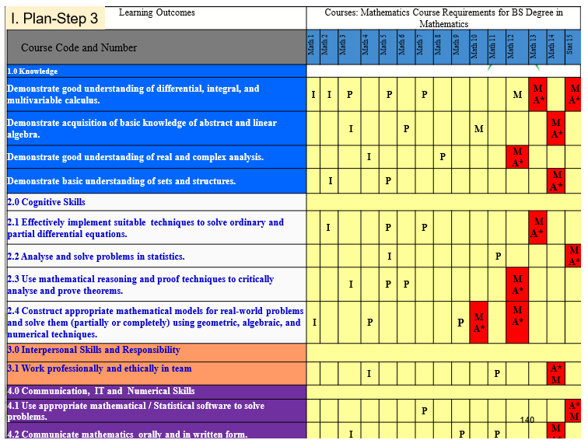

Slide 41
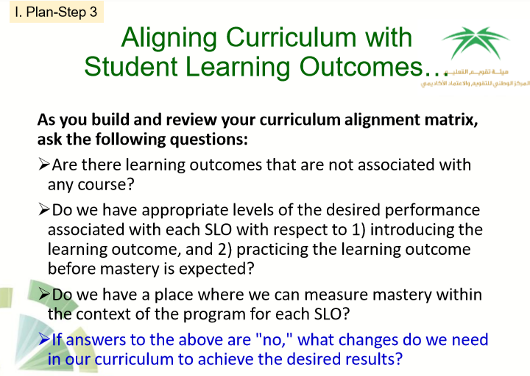

Slide 42
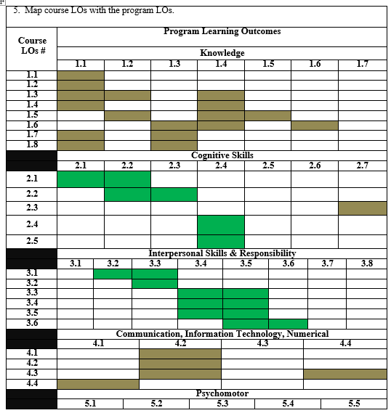

Slide 43
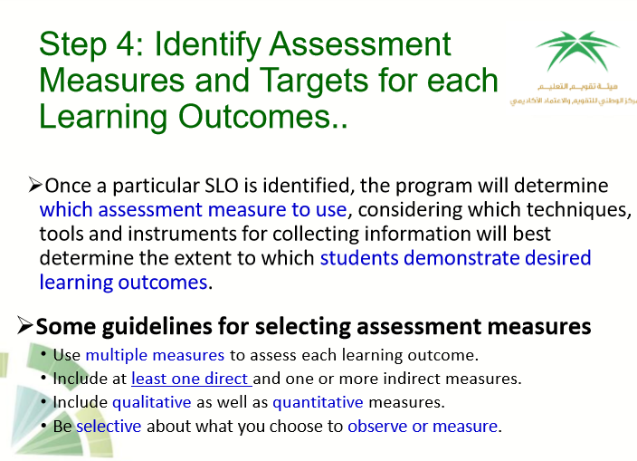

Slide 44
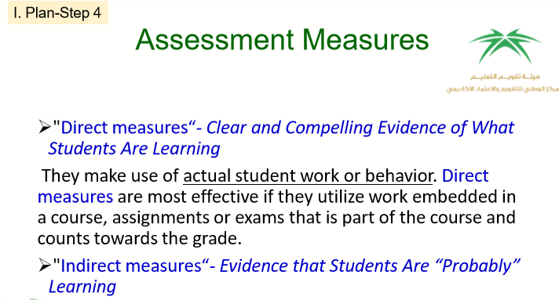

Slide 45
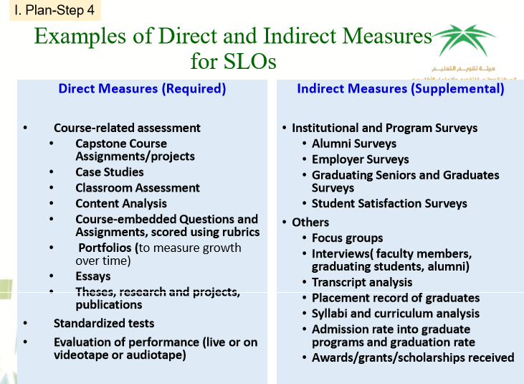

Slide 46
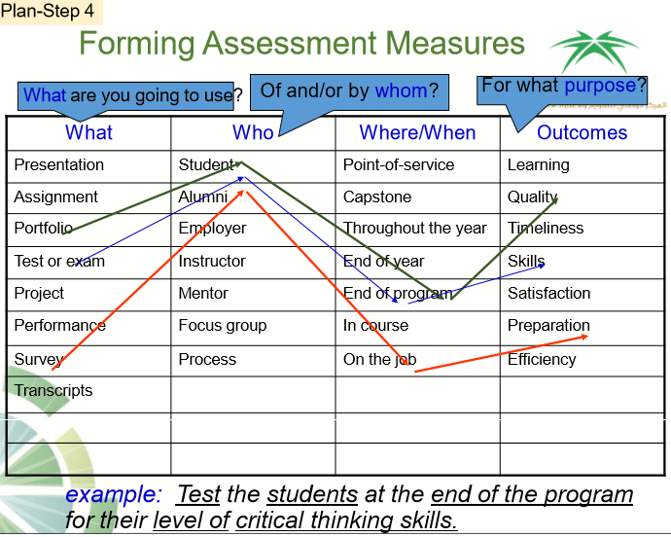

Slide 47
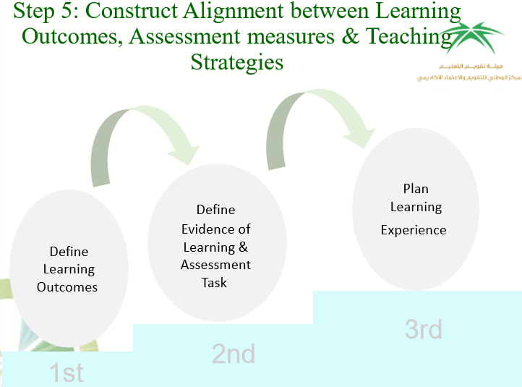

Slide 48
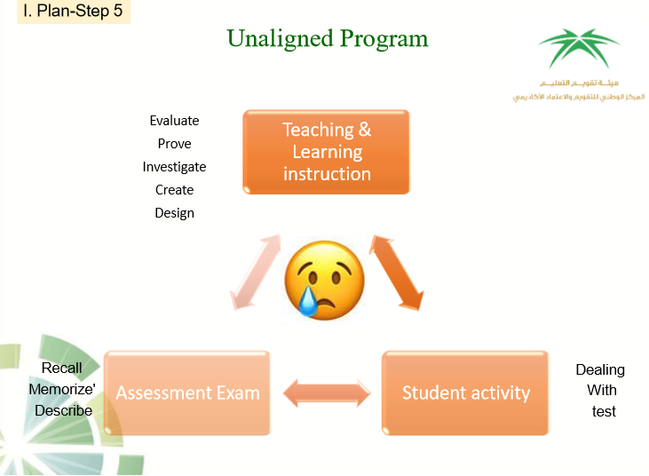

Slide 49
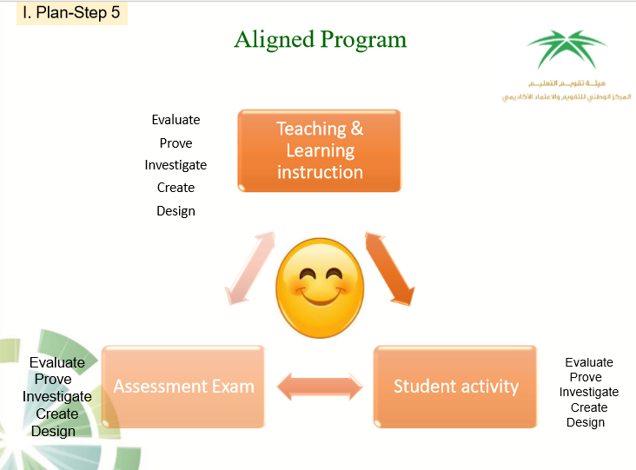

Slide 51


Slide 52
